Slide 1
Troubleshooting Methodology

Slide 2

Troubleshooting Methodology
When a system breaks, what are the appropriate steps to fix the problem?
These steps are known as the Troubleshooting Methodology
Method to solving a problem on computer systems

Slide 3
Troubleshooting Methodology
Identify the problem
Research knowledge base/internet
Establish theory of probable cause
Test theory to determine cause
Establish plan of action to resolve issue
Implement solution
Verify resolution of issue
Document solution for reference

Slide 4
Troubleshooting Methodology
Step 1 - Identify the problem
Gather information
Duplicate the problem, if possible
Question users
Identify symptoms
Determine if anything has changed
Approach multiple problems individually

Slide 5
Troubleshooting Methodology
Step 2 - Research knowledge base/internet, if applicable
Is this a common problem?
See if someone else has had this problem and what steps they took to solve it
Step 3 - Establish a theory of probable cause
Question the obvious
Consider multiple approaches
Divide and conquer

Slide 6
Troubleshooting Methodology
Step 4 - Test the theory to determine the cause
Once the theory is confirmed (confirmed root cause), determine the next steps to resolve the problem
If the theory is not confirmed, establish a new theory or escalate
Step 5 - Establish a plan of action to resolve the problem and identify potential effects
How are you going to solve the problem?
What else could occur when fixing this problem?

Slide 7
Troubleshooting Methodology
Step 6 - Implement the solution or escalate as necessary
Fix the system!
Step 7 - Verify full system functionality and, if applicable, implement preventive measures
Make sure it was actually fixed!
Step 8 - Document findings/lessons learned, actions, and outcomes
Document the issue and what steps were used to fix it
This will help you and/or someone else who comes across the same problem!

Slide 8
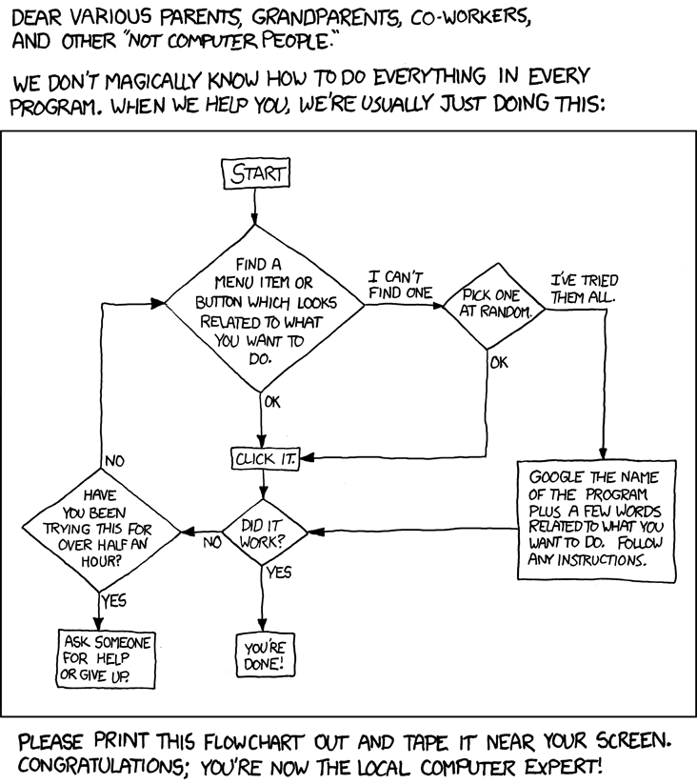
Troubleshooting Methodology
Source:
https://xkcd.com/627/

Slide 9
Troubleshooting Methodology
Identify the problem
Research knowledge base/internet
Establish theory of probable cause
Test theory to determine cause
Establish plan of action to resolve issue
Implement solution
Verify resolution of issue
Document solution for reference

